Slide 1

Hrenciuc Alexandru-Cosmin
Faculty of Electrical Engineering
University POLITEHNICA of Bucharest
Mentor: Ioan-Catalin Damian

Slide 2


Why I chose this opportunity?

Slide 3
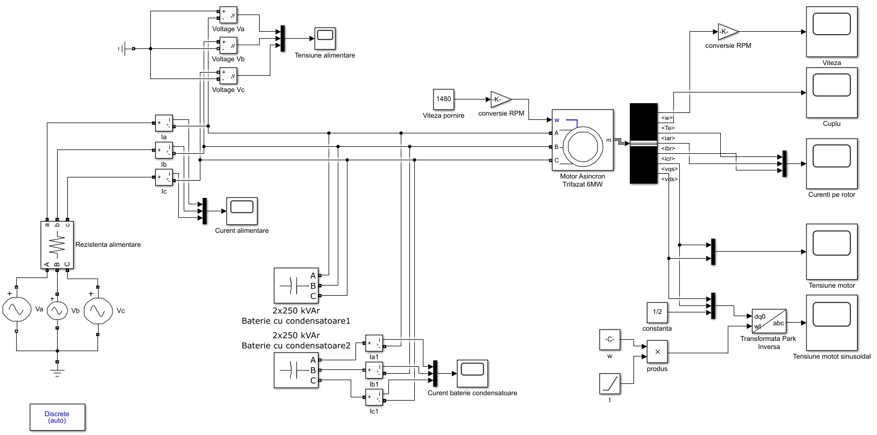
Circuit diagram in Simulink

Slide 4
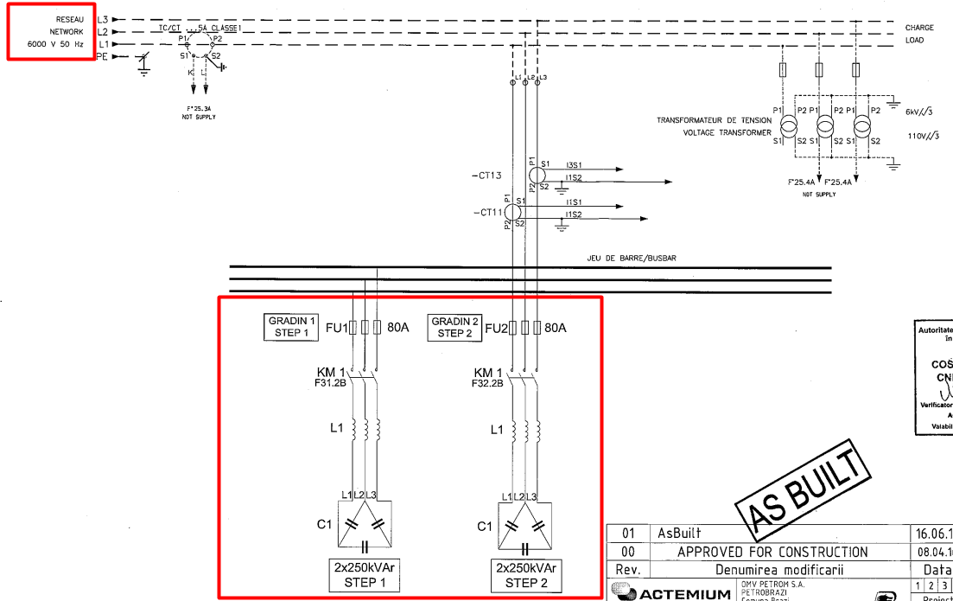
Motor power supply and Capacitor Banks

Slide 5
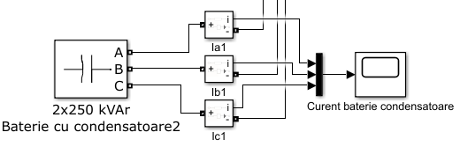
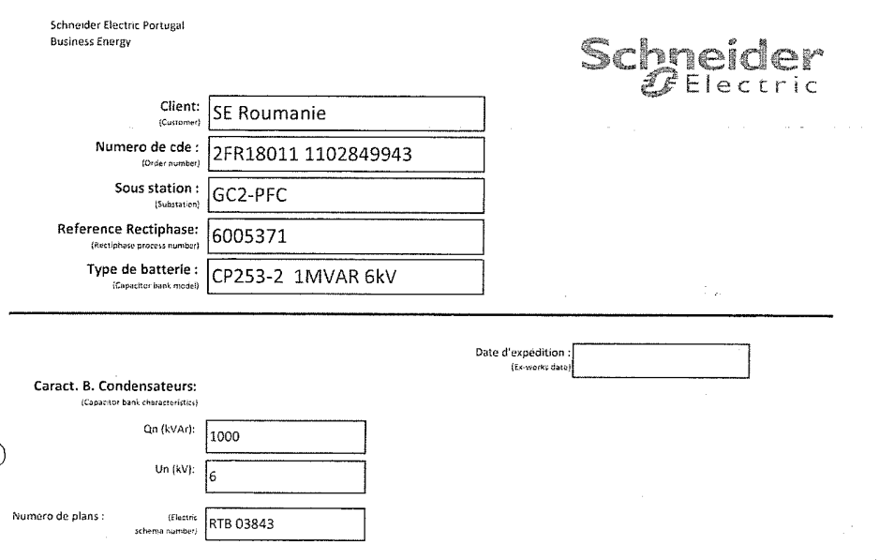
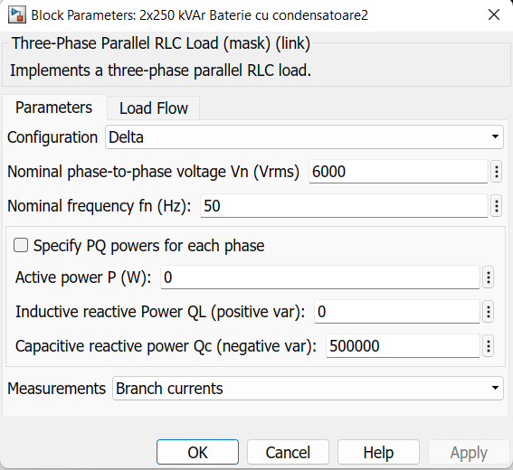
Capacitor Bank

Slide 6
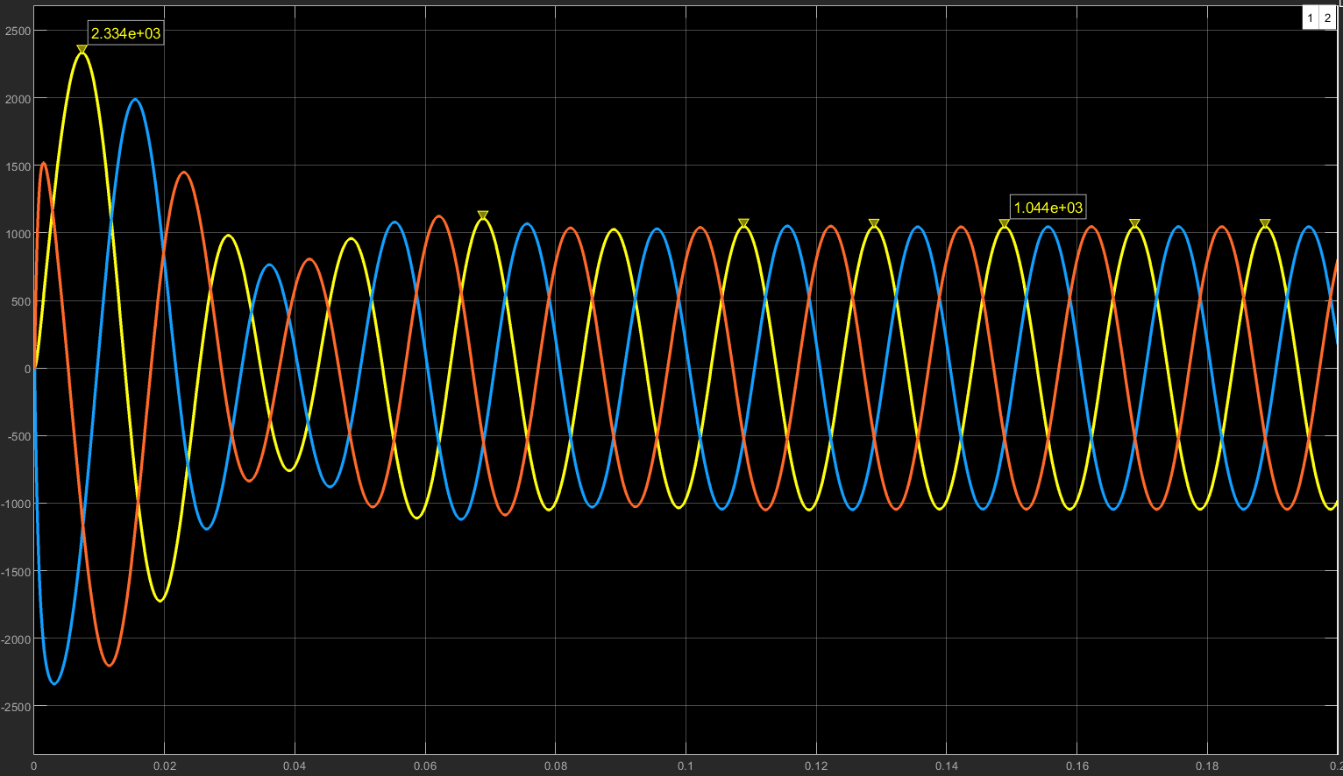
Supply current with Capacitor Banks disconnected

Slide 7
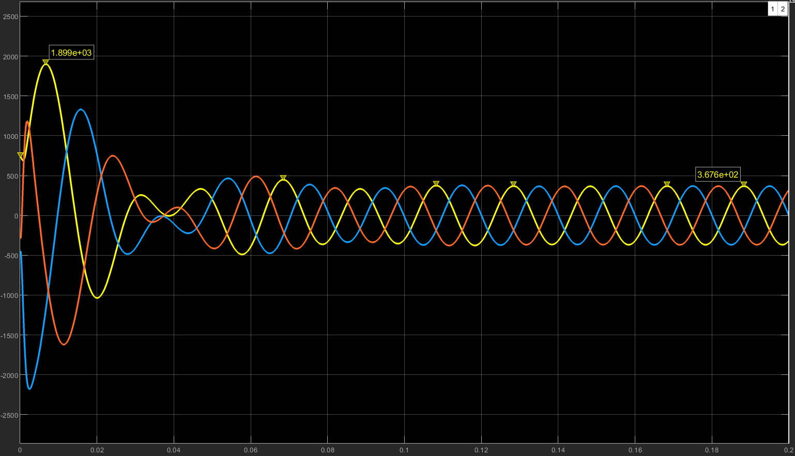
Supply current with Capacitor Banks connected

Slide 8
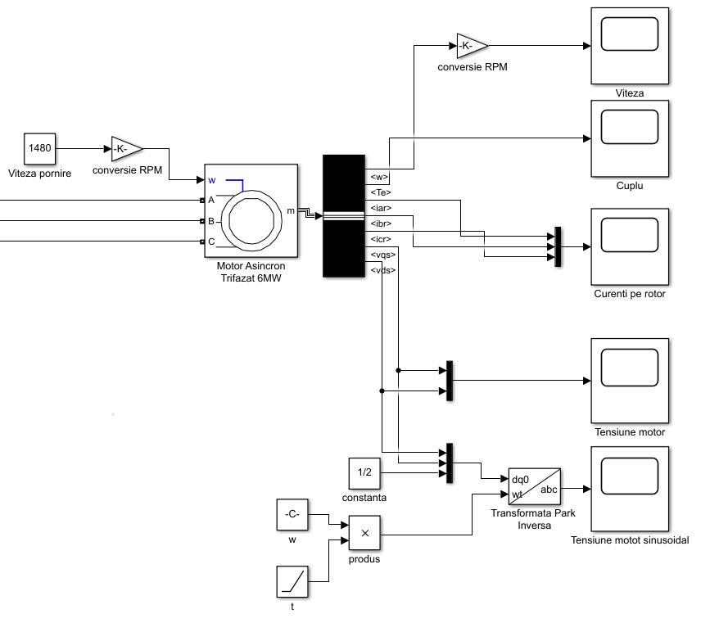
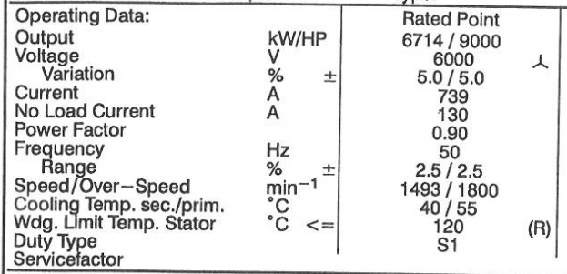
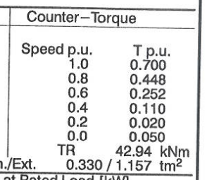
Modeling of GC2 Electrical Motor

Slide 9
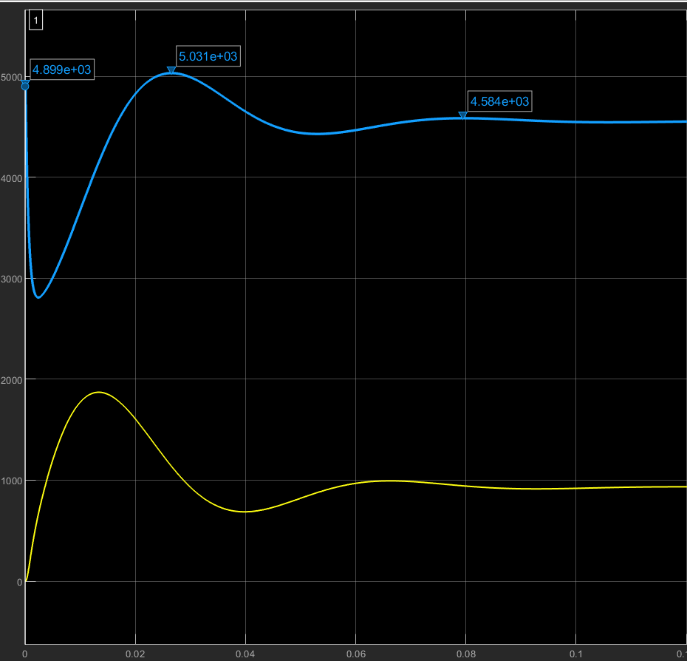
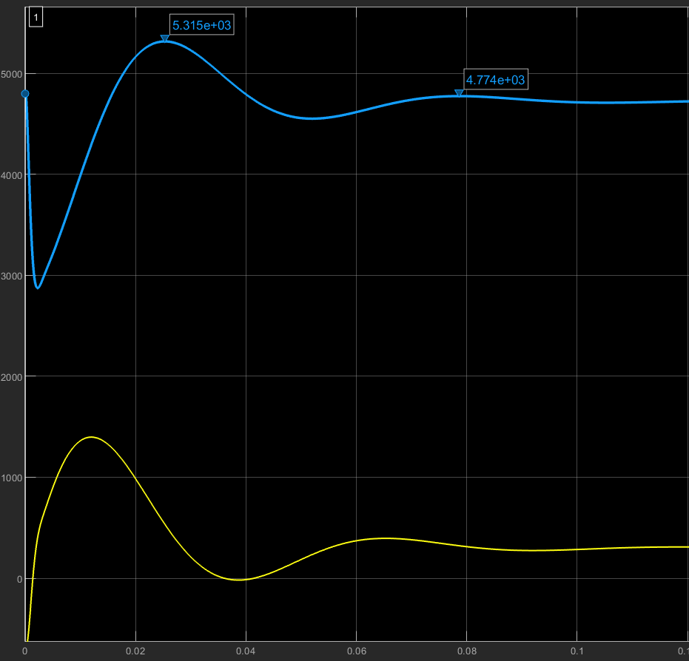
Motor voltage when
Capacitor Banks are disconnected
Motor voltage when
Capacitor Banks are connected

Slide 10
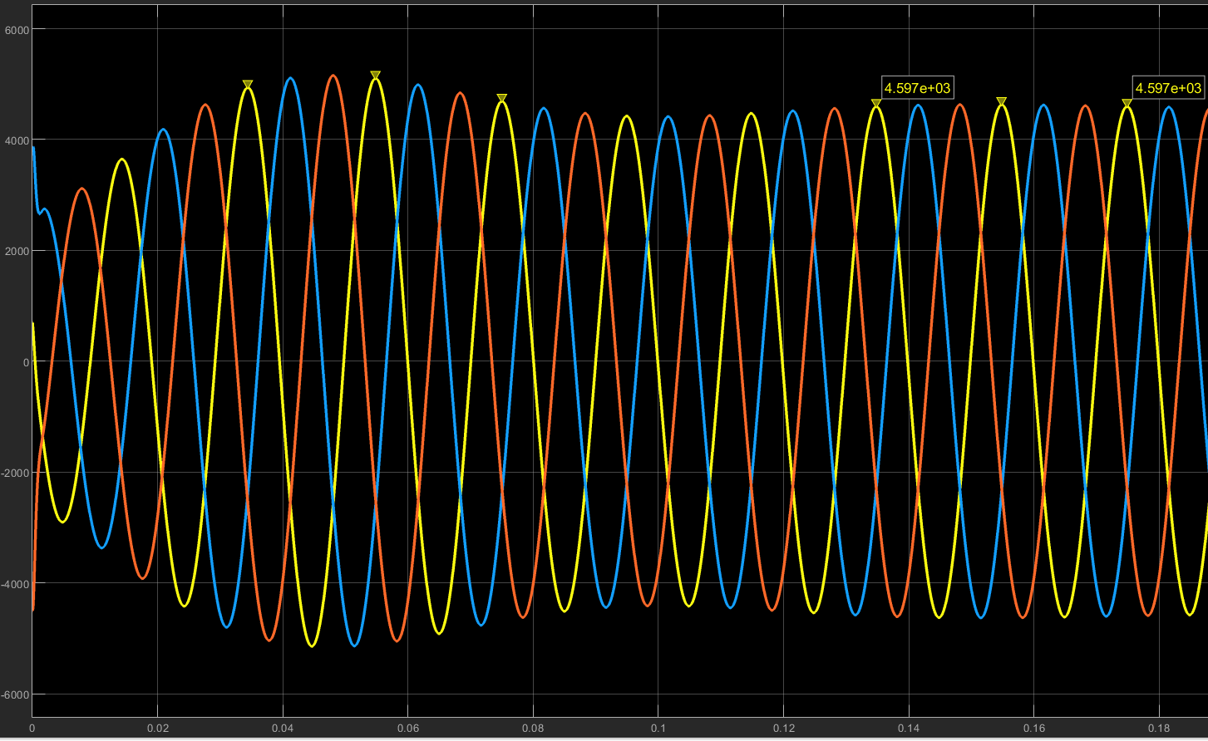
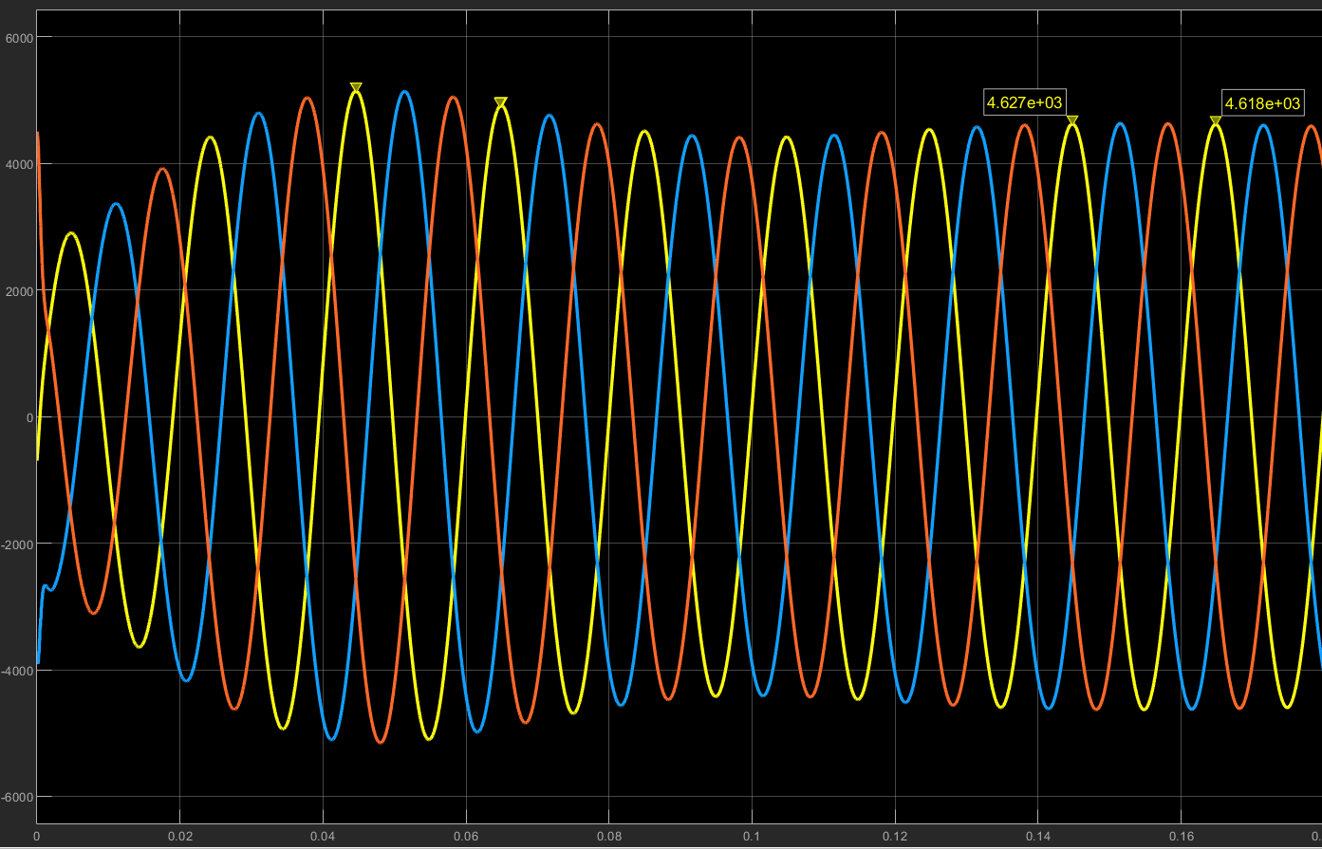
Supply voltage
Motor voltage

Slide 11
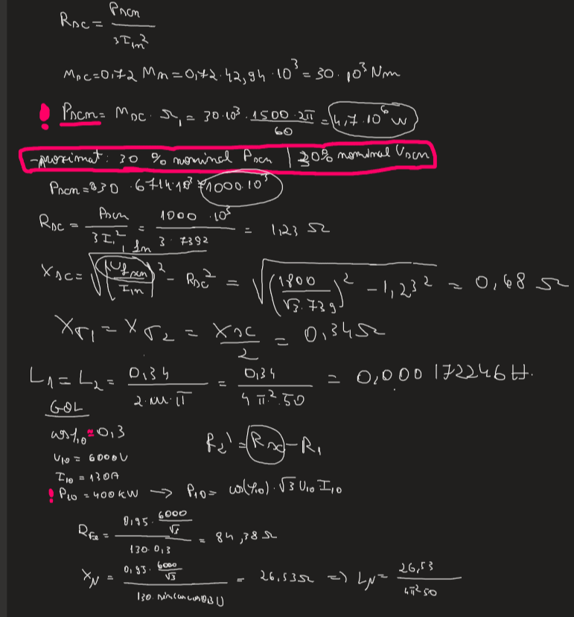
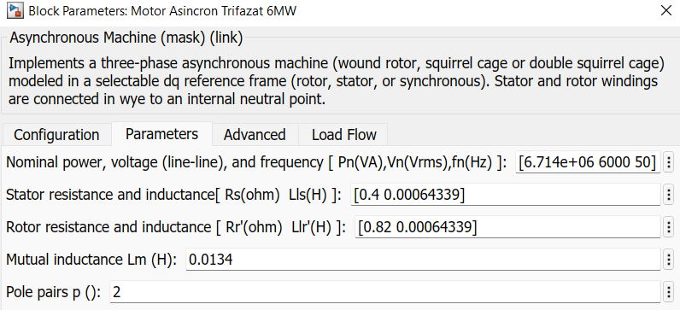
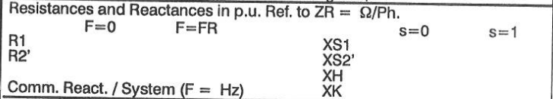
Sidenotes

Slide 12
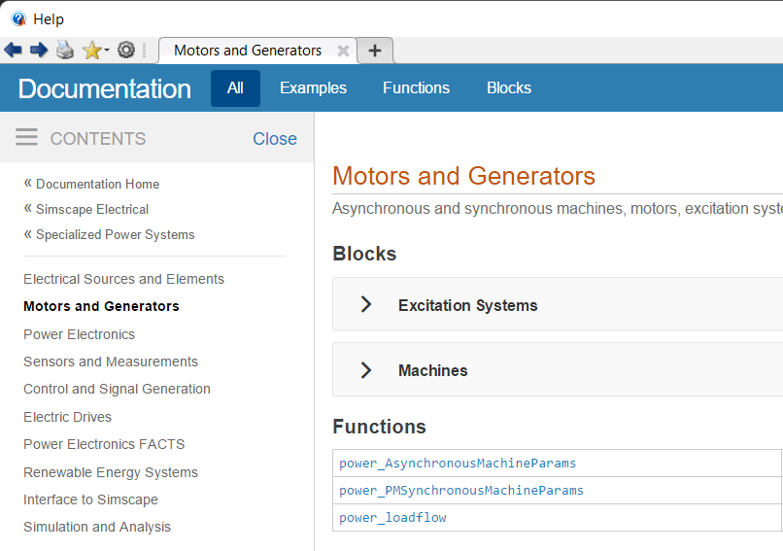
Conclusions
The capacitor bank reduced the motor voltage dropout (7% -> 1%)
Documentation provided by Matlab & Simulink libraries;
Resources from Electrical Machines labolatory;
Technical data from data sheets provided by my mentor

